Slide 1
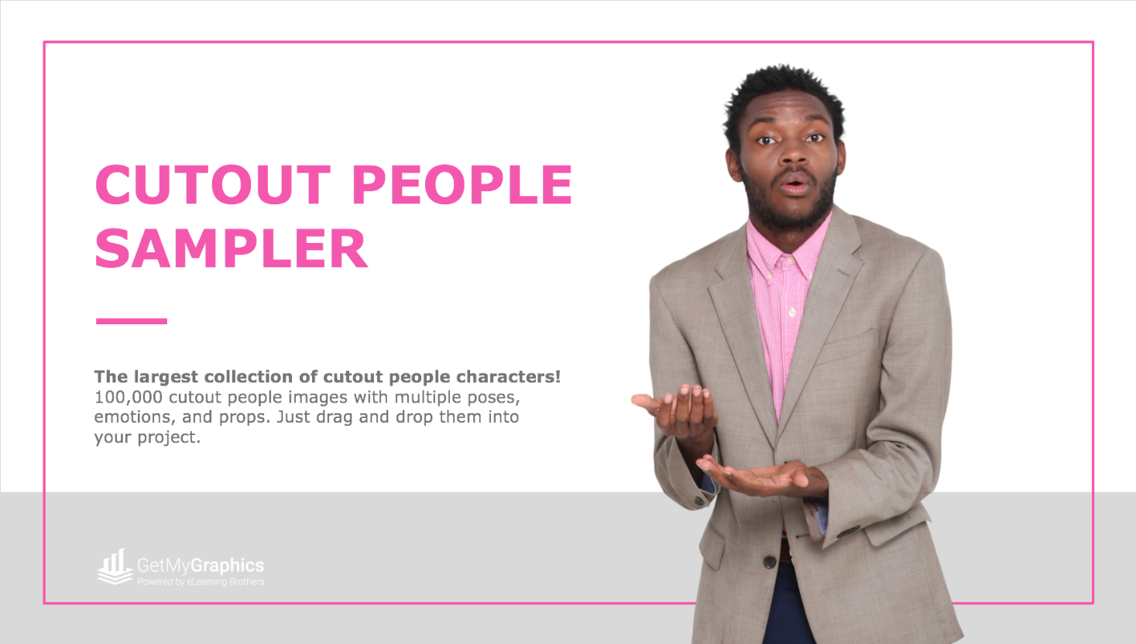

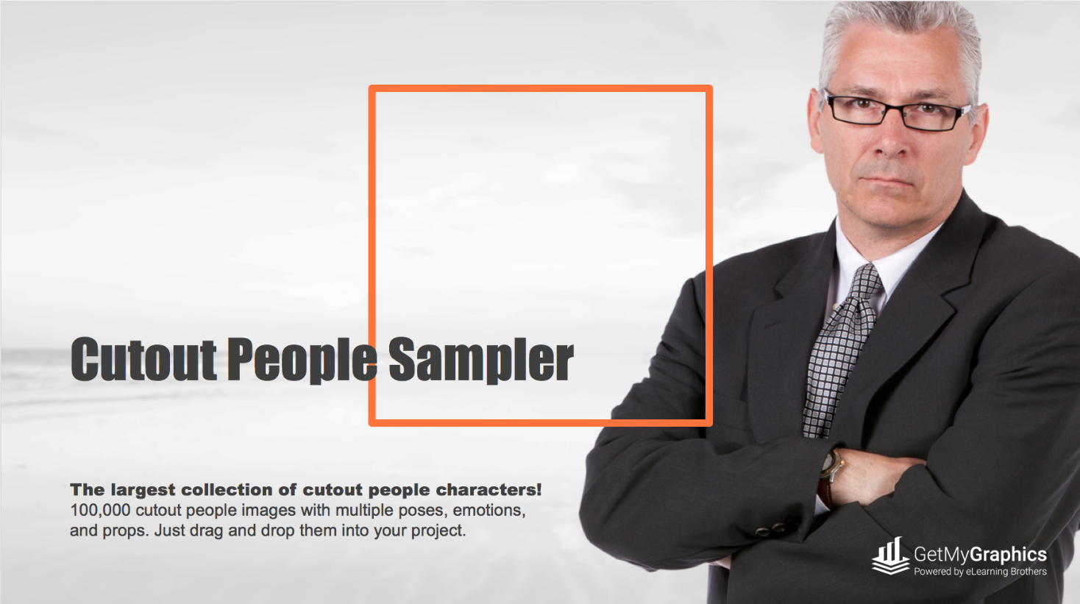
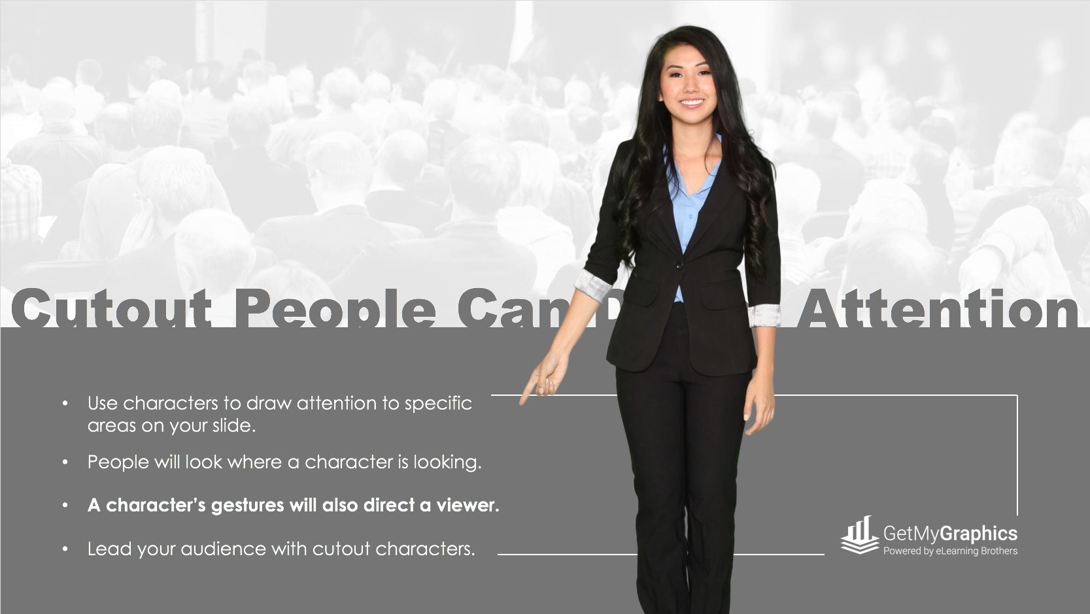
Slide Title Page
PRESENTATION CUTOUT PEOPLE
SAMPLER

Slide 2
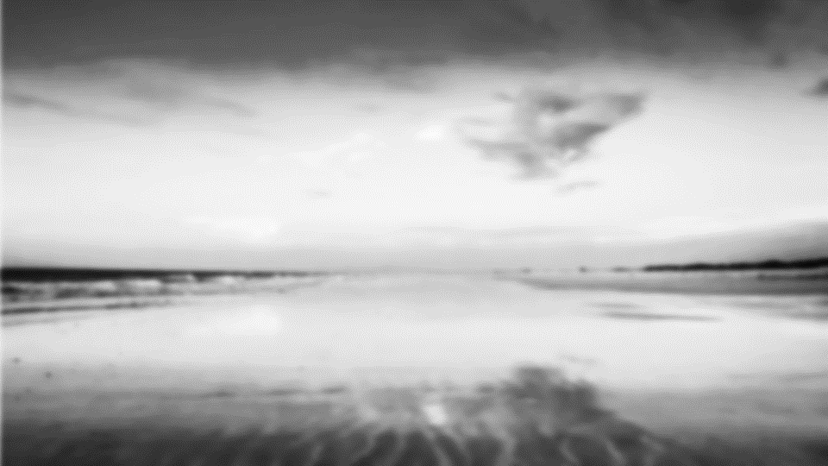

Sample 1
Cutout People Sampler
The largest collection of cutout people characters! 100,000+ cutout people images with multiple poses, emotions, and props. Just drag and drop them into your project.

Slide 3
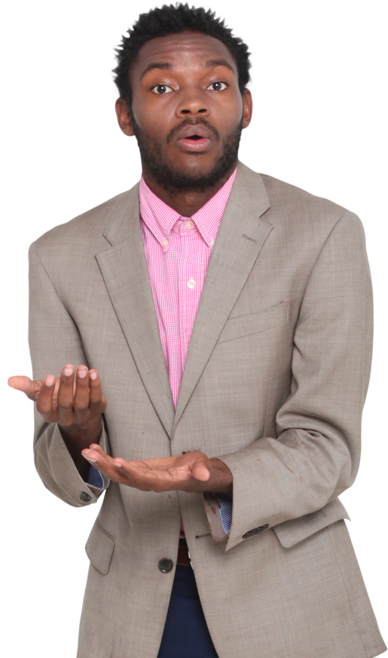
Sample 2
BRING YOUR PRESENTATION TO LIFE
With the largest cutout character library that includes 100,000+ character images, you can be assured that you will find the right character to bring some life into your presentation.

Slide 4

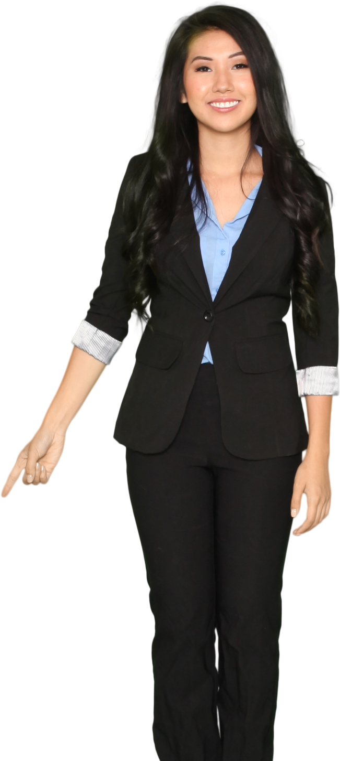
Sample 3
Cutout People Can Direct Attention
Use characters to draw attention to specific areas on your slide.
People will look where a character is looking.
A character’s gestures will also direct a viewer.
Lead your audience with cutout characters.

Slide 5

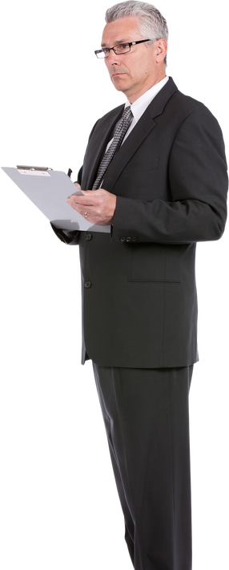
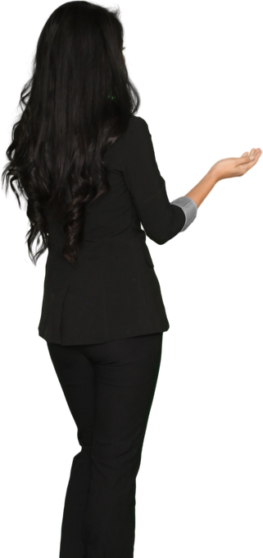

Sample 4
Custom Interactions
Everything you need to build realistic interactions.
Adding scenarios where multiple people are interacting creates real emotion in your slides.

Slide 6




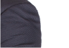
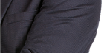


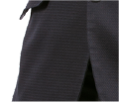
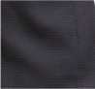
Sample 5
Layering
Enhances
Interest
Layer the same character to create great effects.
By cropping multiple images of the same character, you can generate different effects and animations that will add that extra interest your slide has been missing. Let your creative side take over and get ready to be amazed.

Slide 7
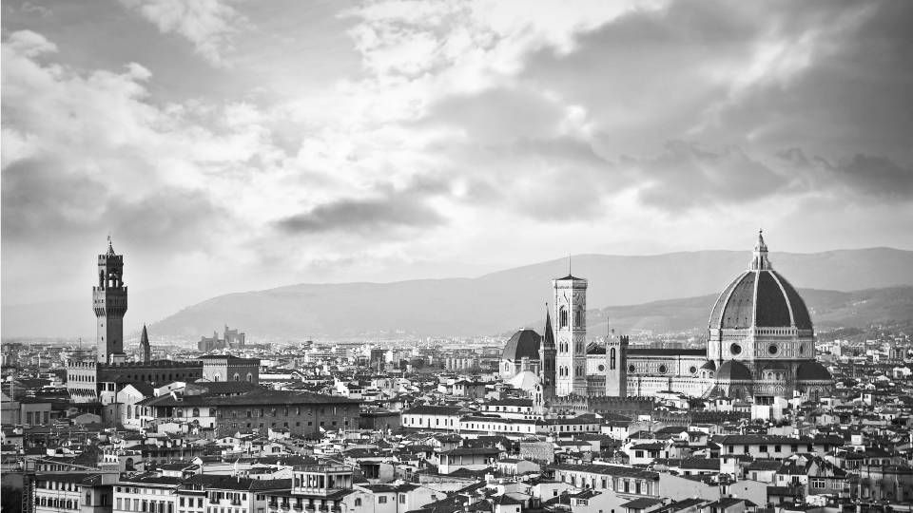

Sample 6
ENGAGED
KEEP THE AUDIENCE
Viewers respond better to incoming information when they feel like there is a sense of human interaction. You can also dictate the emotion of each of your slides with cutout characters. Characters keep your audience engaged in your presentation.

Slide 8

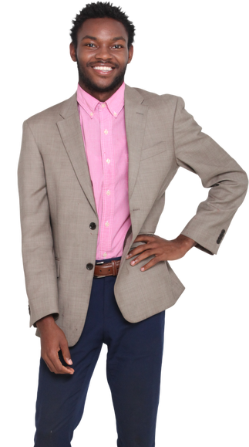
Sample 7
PEOPLE TRUST PEOPLE
The right character can help people trust your information.
Make the look of your presentation match its content.
Just drag and drop characters into your project.

Slide 9
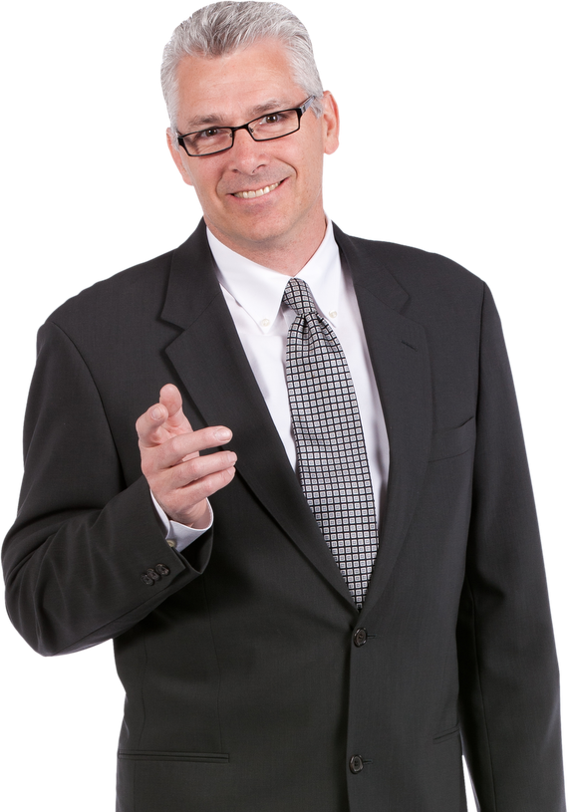
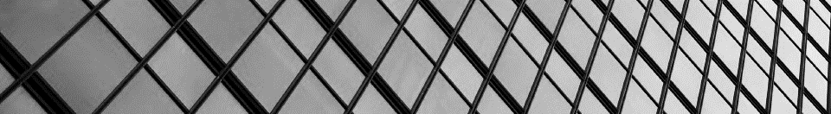
Sample 8
GET MORE OUT OF YOUR PROJECT
Multiple poses, emotions, and props bring your presentation to life. Just drag and drop them into your project to boost it to the next level. Elevate your presentations by adding cutout people.
LEARN MORE

Slide 10

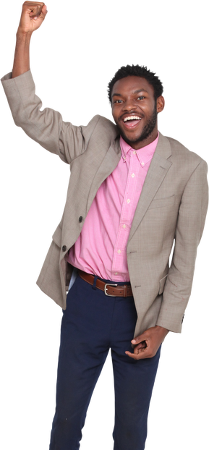


Sample 9
People
Can Add
Excitement
Use cutout characters images to add excitement to a slide or topic. Choosing the right emotion from a large selection of characters can help bring more excitement to your slides and presentations.

Slide 11
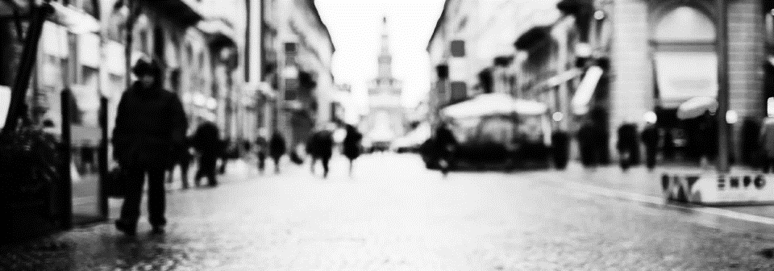
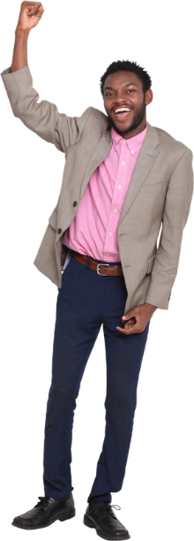
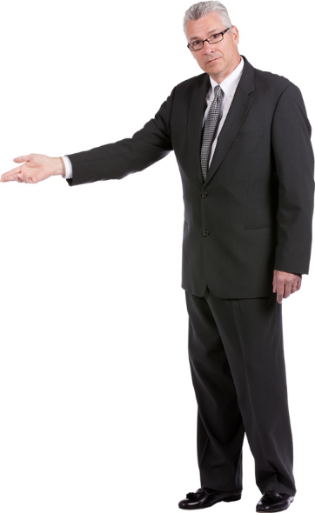
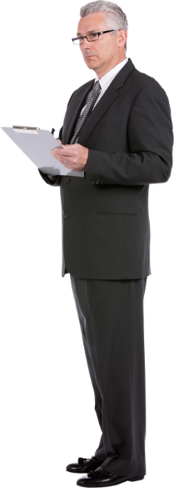

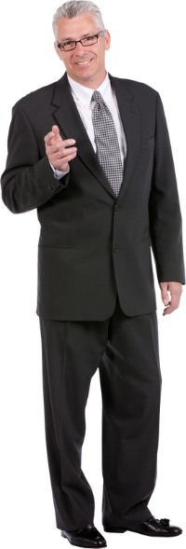
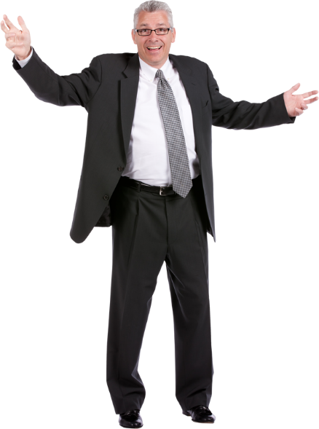


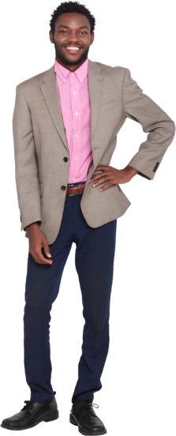
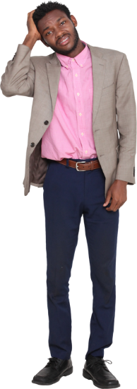
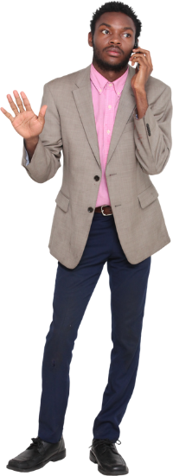
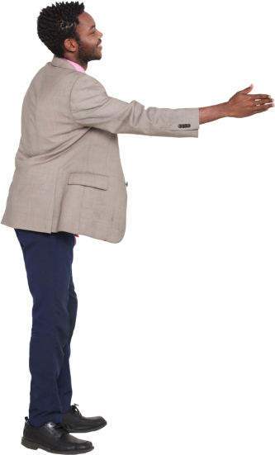
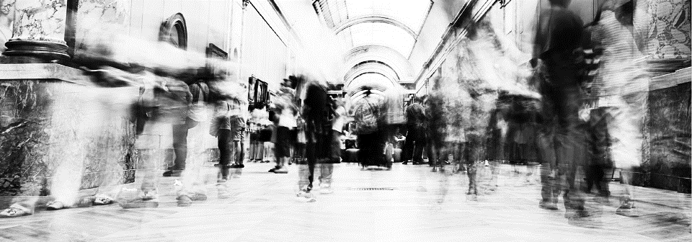


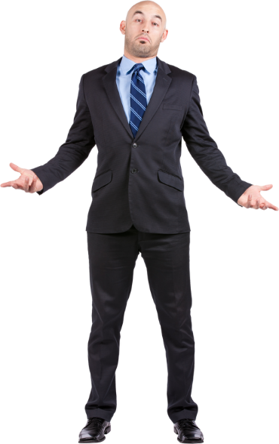

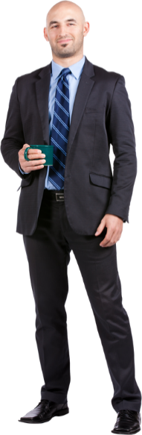
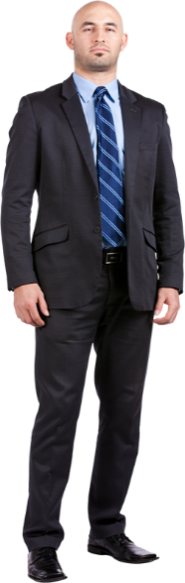
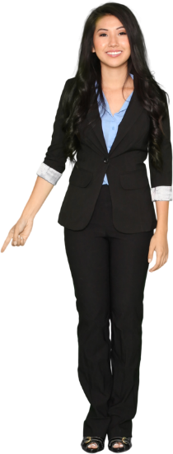
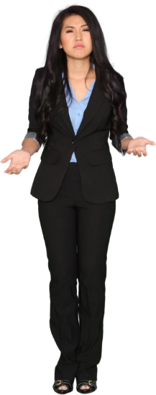
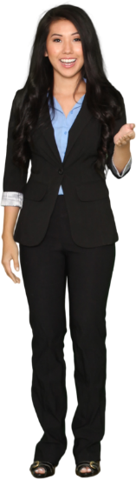

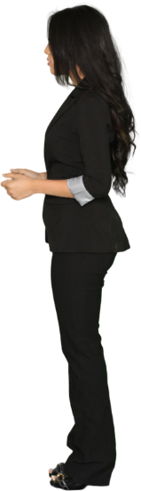
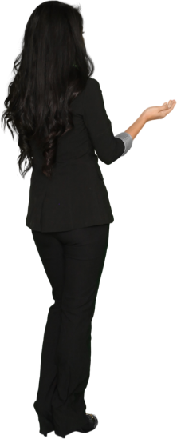

Character Pose Slide
FREE
CUTOUT CHARACTERS
Here are multiple poses of the characters in this presentation so that you can continue to use them in other creative slides. Simply copy and paste these images on your slide and adjust the image size.
Jack
Steve
Vicky
Max

Slide 12
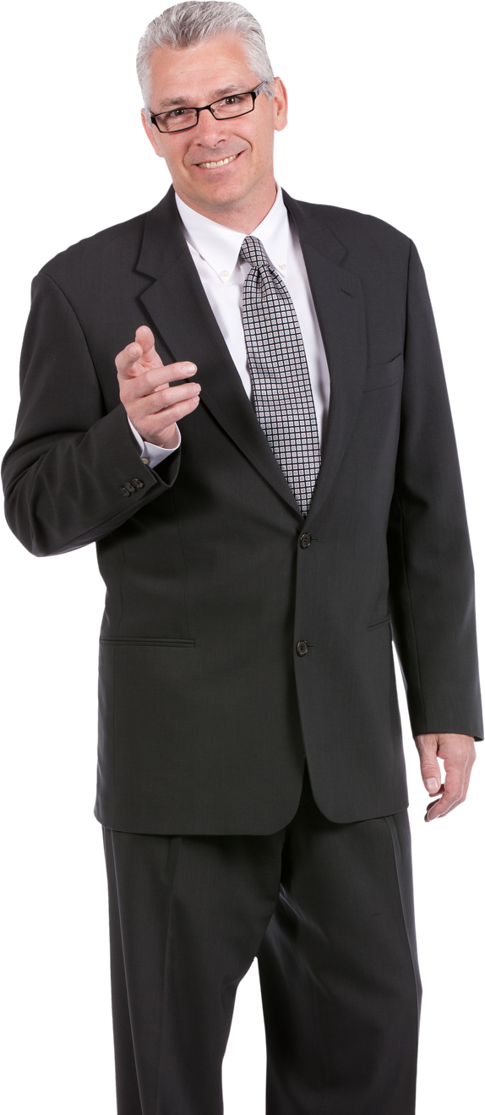
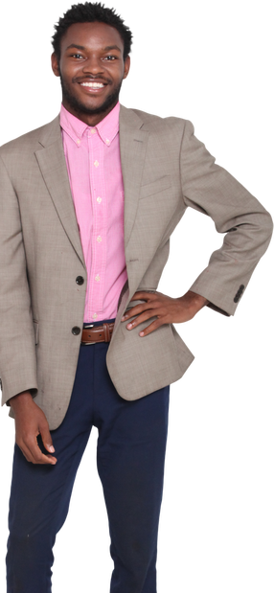
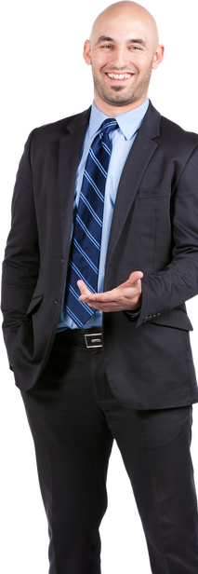
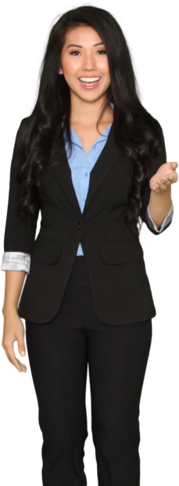
Call To Action Slide
100,000+ cutout people images.
Get FREE access to 1,000s of character images.
CLICK HERE
to Check Out the Cutout People Library!

